Slide 1
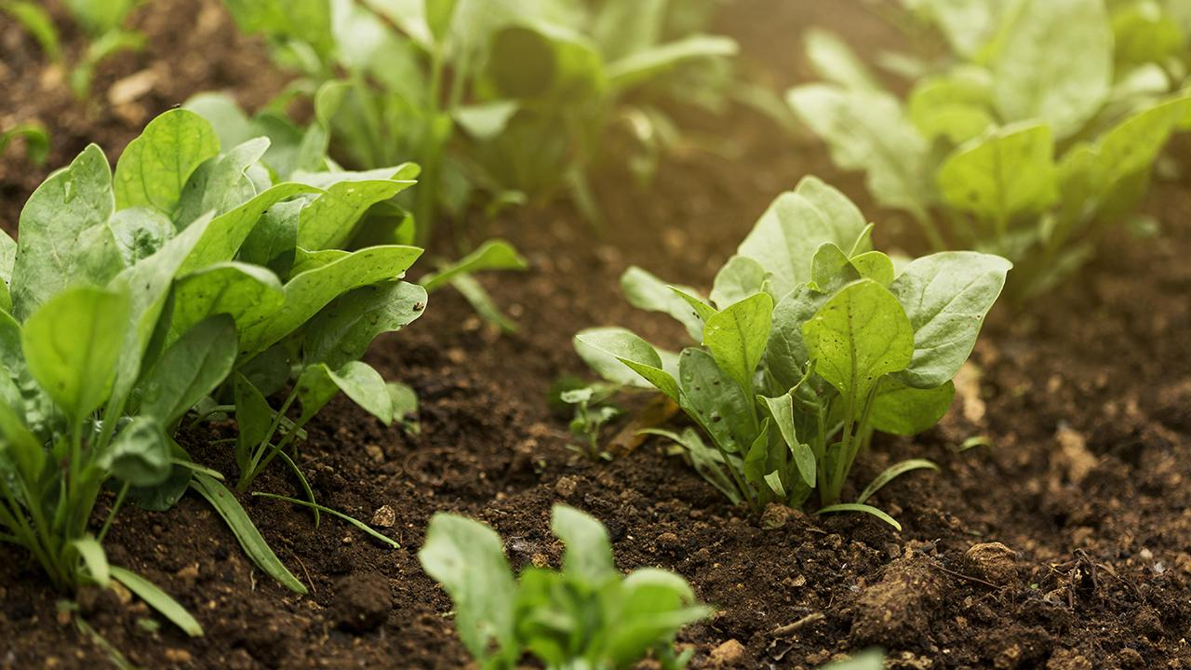
Optimising Agricultural Production
Fertilizer Creation and Companion Planting
Akhil Khurana

Slide 2
Problem Statements
Identification of crops which require extreme weather conditions and higher nitrogen content
Possibility of Companion planning within the given dataset
Creation of fertilizer on the basis of nitrogen, phosphorus and potassium content in the soil
Problem Statement
Analysis
Solution / Insights

Slide 3
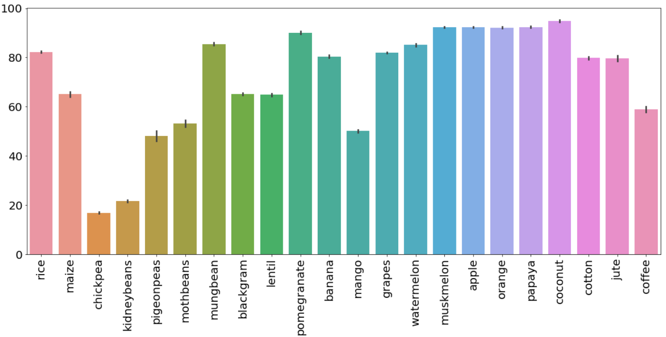
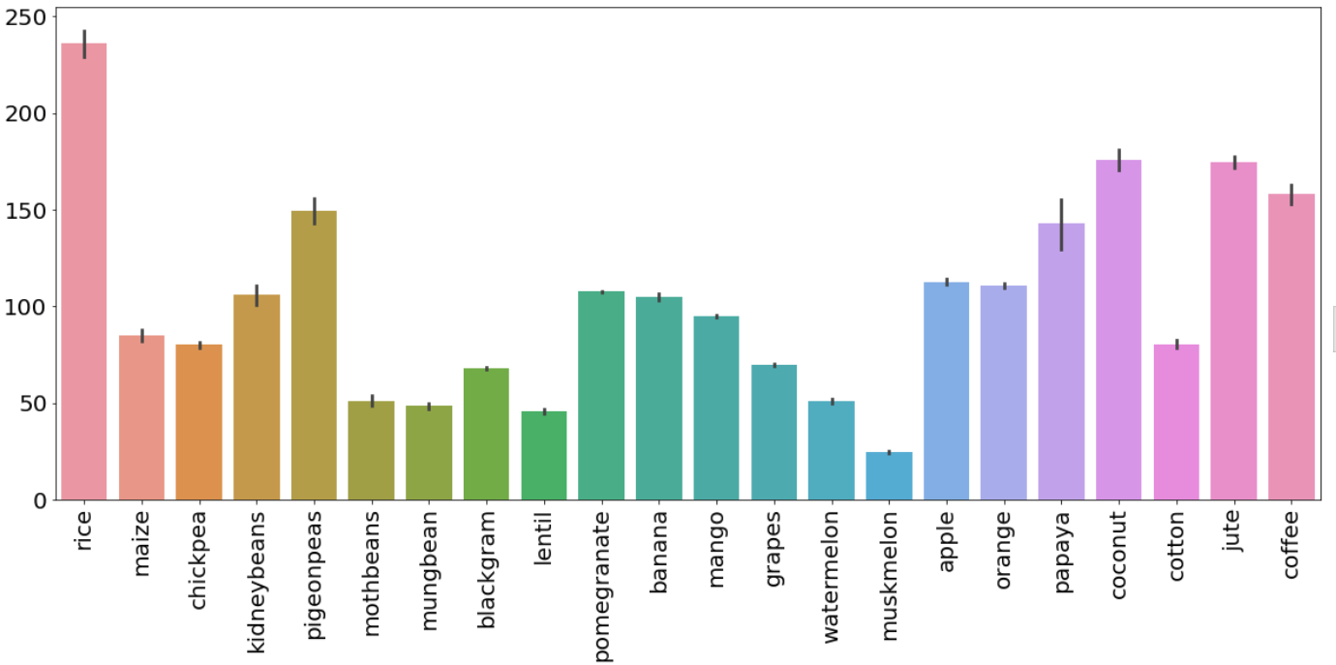
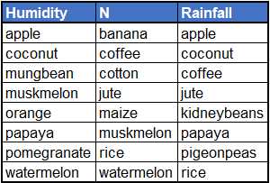
Analysis
Humidity and Label
Rainfall and Label
We have taken the cut-off for extreme weather as greater than 75% of the data. We can clearly see the crops exceeding this limit from the above bar-plots.
We have taken the cut-off for extreme weather as greater than 75% of the data. We can clearly see the crops exceeding this limit from the above bar-plots.
Crops which can withstand extreme weather conditions and Nitrogen content
The above clusters have been identified. We can see that crops are repeating across clusters and the reason is that the crops can grow across different kinds of soil/ weather conditions.
Problem Statement
Analysis
Solution / Insights

Slide 4
Solution / Insights
Requirement for fertilizers:
Pulses (Blackgram, Kidneybeans, Lentil, Mothbeans, Mungbeans, Pigeonbeans) require less nitrogen and potassium but high phosphorus.
Grapes and apple require extreme potassium and phosphorus in soil but less nitrogen
Companion Planning:
Coconut, coffee, jute, papaya, pigeonpeas and rice require high temperature, Ph and humidity and hence can be grown together
Problem Statement
Analysis
Solution / Insights

Slide 5
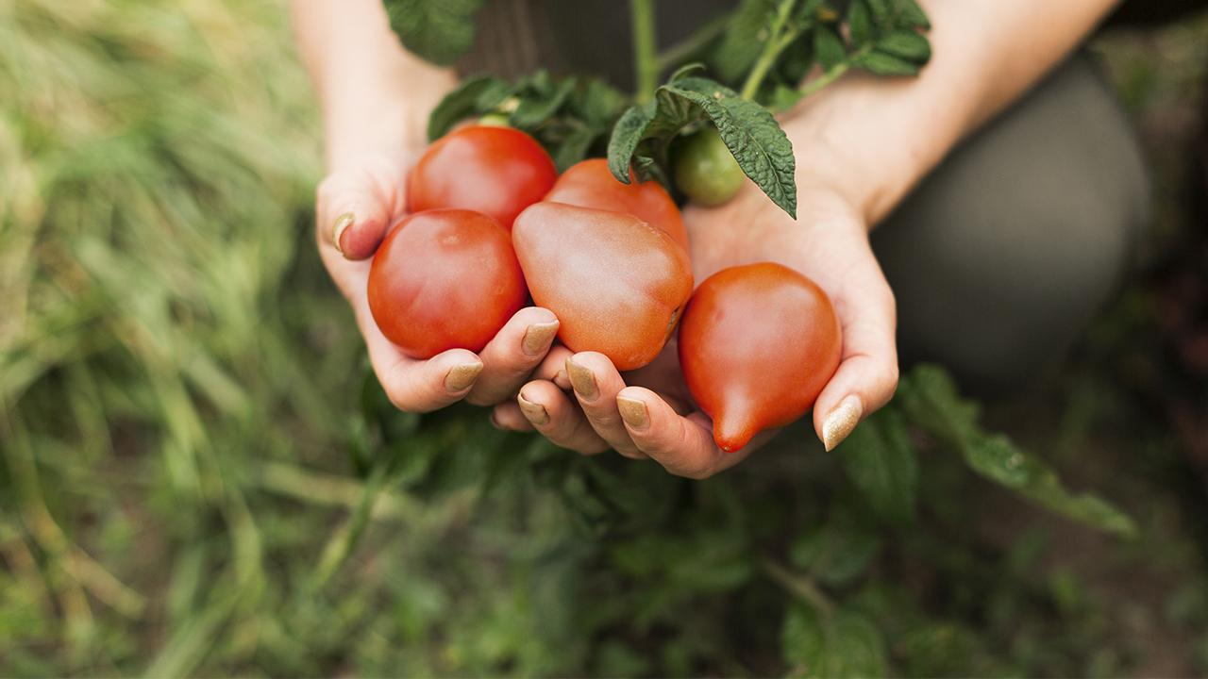
Thank you

